Slide 1
Is Peace Possible?
David Swanson

Slide 2
Raise your hand if . . .
you think war is never ever justified.
you think some wars are sometimes justified for some participants.
Notes:
How about if you know someone who thinks some wars are sometimes justified for some participants? We’re going to come back to this.

Slide 3
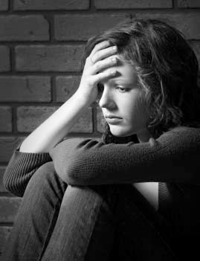
Now raise your hand if you think . . .
humans just can’t be rid of war, whether or not it’s ever justifiable.
Notes:
Explain why you think that.

Slide 5
Things That Used to Be “Inevitable”
cannibalism, human sacrifice, trial by ordeal, blood feuds, dueling, polygamy, capital punishment, serfdom, plantation slavery, an all-male electorate, Jim Crow segregation, an all-male military, bans on homosexuality, the election of Hillary Clinton

Slide 6
War is not inevitable
Absent for most of human prehistory.
Sporadic since its creation.
Unknown to many societies.
Unlike its current form until virtually this moment.
Avoided by most who can.
Damaging to most who take part.

Slide 7
0
Number of recorded cases of post traumatic stress disorder, brain injury, moral injury, loss of limb, or suicidal tendencies as a result of war deprivation.

Slide 8
96%
Percent of humanity whose governments each spend a fraction of what the U.S. government does on war, and whose governments combined spend about what the U.S. government does on war.

Slide 9
Human Nature does not exist.

Slide 10
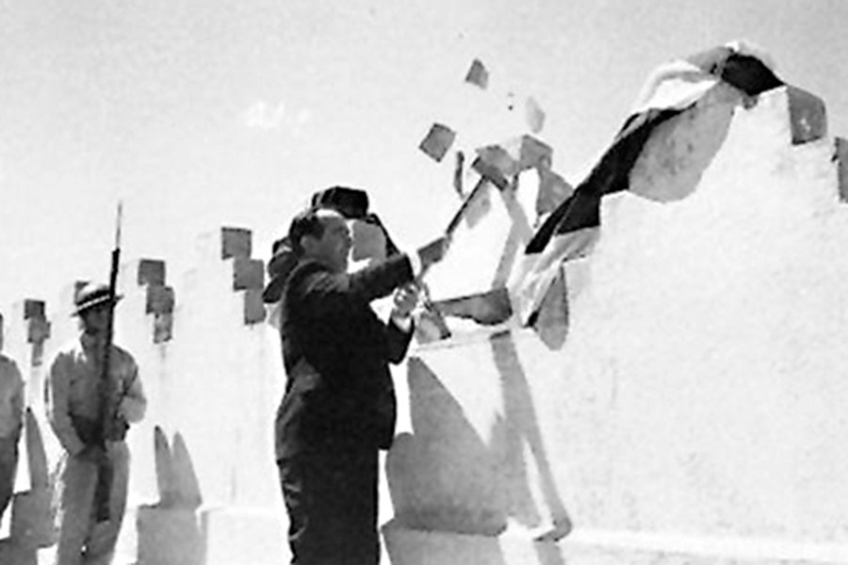
Countries with no standing army
Costa Rica, Iceland, Mauritius, Monaco, Panama, Vanuatu, Andorra, Dominica, Grenada, Kiribati, Liechtenstein, Marshall Islands, Federated States of Micronesia, Nauru, Palau, Saint Lucia, Saint Vincent and the Grenadines, Samoa, Solomon Islands, Tuvalu, Vatican City.

Slide 11
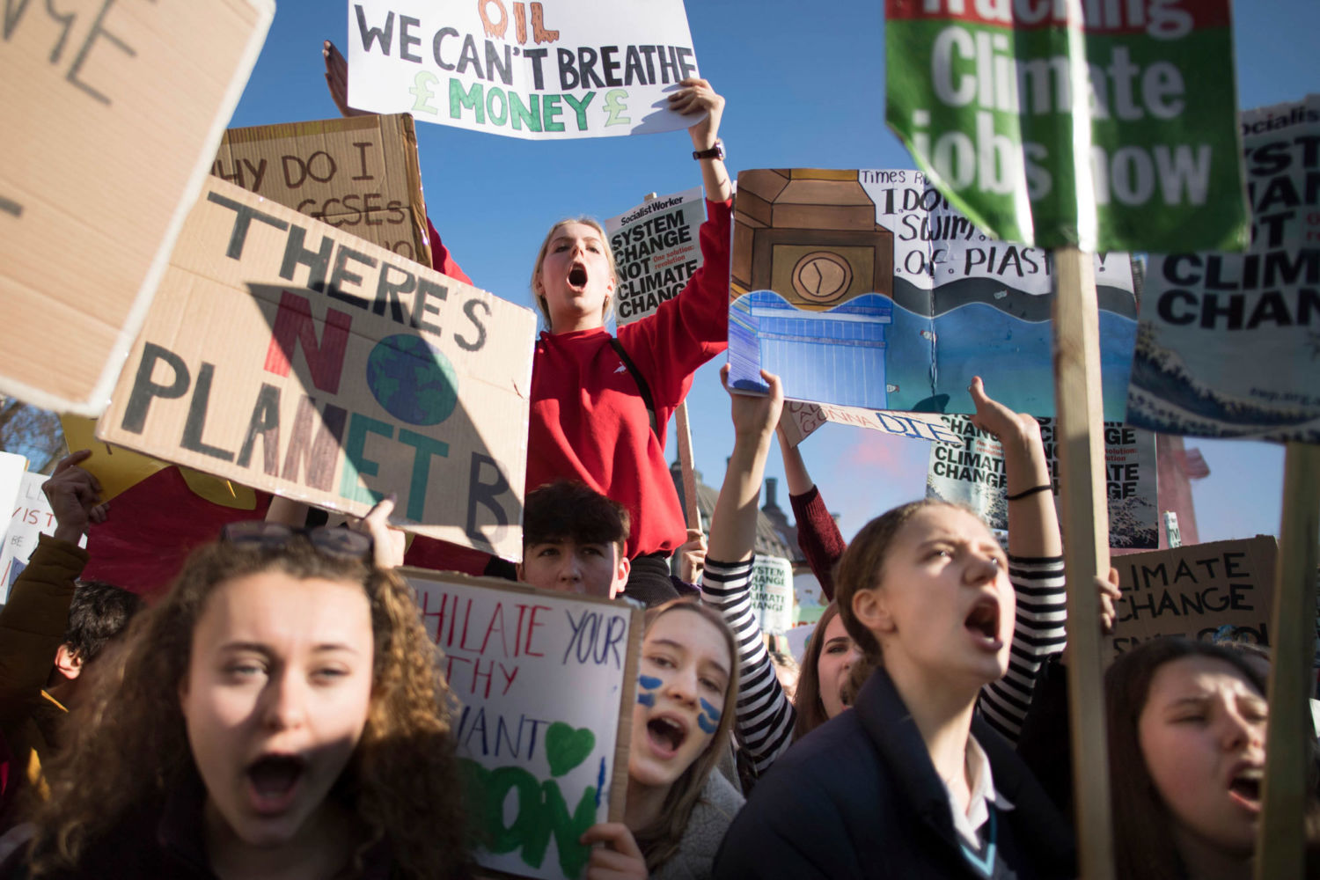
War can be ended with or without ending . . .
Capitalism,
Racism,
Carnivorism,
Environmental destruction.
But we have a larger movement if we take on multiple interlocking evils together.

Slide 13
Nonviolence Denial is as dangerous as climate denial
What happened in . . . ?
Germany 1920, Germany 1923, Algeria 1961, Czechoslovakia 1968, Soviet Union 1991,

Slide 14
POP QUIZ
What tends to be present where wars are begun?
—resource scarcity,
—human rights violations in need of response,
—raw fossil fuels.

Slide 15
Notes:
Polls in the United States through the 2003-2011 war on Iraq found that a majority in the U.S. believed Iraqis were better off as the result of a war that severely damaged — even destroyed — Iraq[1]. A majority of Iraqis, in contrast, believed they were worse off.[2] A majority in the United States believed Iraqis were grateful.[3] This is a disagreement over facts, not ideology. We have yet to see a humanitarian war benefit humanity. Often those pointed to are wars that “should have happened.”

Slide 16
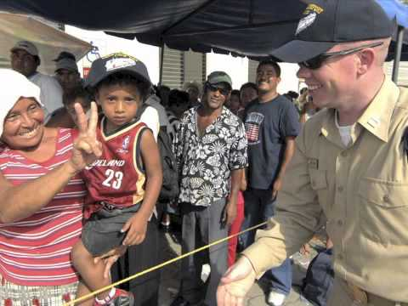
Notes:
First 45 seconds

Slide 17
Now a Magic Trick
If you said that some wars are sometimes justified, think of the name of one such war and shout it out.

Slide 18
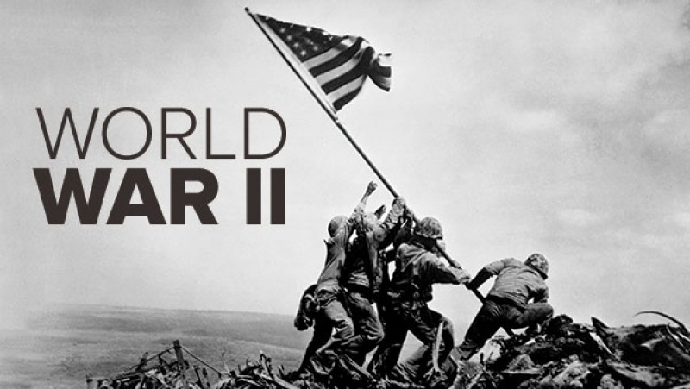
Now a Magic Trick
If you said that some wars are sometimes justified, think of the name of one such war and shout it out.

Slide 19
WWII was the worst war, not the good war
Greatest damage, cure worse than disease. Continuation of WWI. No surprise. No humanitarianism -- What is Evian? Not defensive. 80% did not fire. Total war. U.S. Nazi roots. Origins of “good war.” Never ending bombs, spending, taxes, bases. Irrelevance to today.

Slide 20
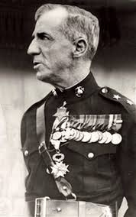
Who is this guy?

Slide 21
Smedley Butler
“Have you ever heard a leader roundly condemned for preserving peace?” —speech at UVA, 1937
The perversity of the world of the WWII myth.
No way left to end wars.

Slide 22
“No war by any nation in any age has ever been declared by the people.”
Who said that?

Slide 23
POP QUIZ
The U.S. sells or gives weapons to this % of most oppressive governments on earth:
12%
52%
82%

Slide 24
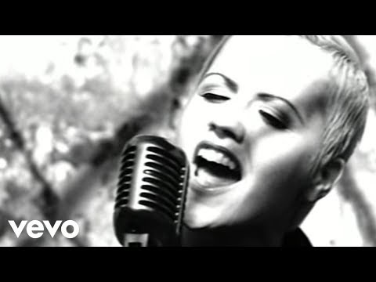
Notes:
1:12 to 1:45 Zombie ideas

Slide 25
A future without zombie ideas
Only the future matters.
Raise your hand if you can imagine a justifiable war in the future.

Slide 27
The problem with Just War Theory
Where it comes from. What it does. Its criteria: Immeasurable: Right intention, just cause, proportionality Impossible: Last resort, reasonable prospect of success, noncombatants free from attack, enemy soldiers respected, prisoners treated as noncombatants. Amoral: Publicly declared, legitimate authority
Justifying the institution.
What does more damage, war or preparations for war?

Slide 28
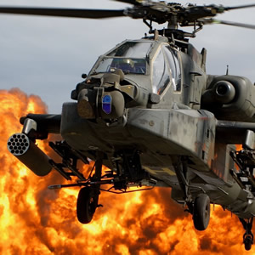
We need $2 trillion/year for other things War threatens our environment War erodes liberties War promotes bigotry War endangers us War impoverishes us War is immoral
We need to abolish the whole institution.

Slide 29
Peace has to be carefully avoided
It takes extreme efforts to create war.
Mexico Spain Vietnam Iraq Afghanistan Iraq Libya Syria Iran Drones
Peace has to be constructed
Unless we change the systems and structures and culture we live in, people will go on making those extreme efforts and creating wars. Reverse arms race International law and democracy Aid, cooperation, diplomacy Unarmed, civilian peacekeeping A culture of peace Replacing exceptionalism with humanism

Slide 30
POP QUIZ
What % of top 4 weapons-dealing nations are permanent members of UN Security Council?
0%
25%
50%
100%

Slide 31
What can we do?
Reverse Arms Race
Close Foreign Bases
International law
Aid, diplomacy
Unarmed peacekeeping
Culture of peace
Cure exceptionalism
Prevent and end particular wars

Slide 32
Not Predictions, Not Optimism, Not Pessimism
ACTIVISM!
WorldBEYONDWar RootsAction Education, Divestment, Bases, Lobbying, Protesting, Coalition Building

Slide 33
“When I rise it will be with the ranks, not from the ranks.”
Who said that?

Slide 34
Raise your hand if . . .
You’re more inclined to believe that we can / should / must end all war than you were an hour ago.
Or if you think more than an hour might move you.
Or if you think others not in this room might be moved in the right direction with the right information.

Slide 35
The Declaration of Peace has been signed in almost every country:
I understand that wars and militarism make us less safe rather than protect us, that they kill, injure and traumatize adults, children and infants, severely damage the natural environment, erode civil liberties, and drain our economies, siphoning resources from life-affirming activities. I commit to engage in and support nonviolent efforts to end all war and preparations for war and to create a sustainable and just peace.
Sign at worldbeyondwar.org/individual
worldbeyondwar.org/organization

