Slide 1
Outgrowing Religion, Nationalism, and Militarism
Remarks to Phoenix Humanist Society, January 24, 2021
By David Swanson

Slide 2
More than just a positive statement of a negative
Atheism
Humanism
Antimilitarism
World BEYOND War

Slide 3
Imagine all the people living for today

Slide 4
Every belief is subject to change

Slide 5
We die. Who knew?

Slide 6
Could be true says New York Times

Slide 7
Inability to imagine as proof of impossibility

Slide 8
Imagine

Slide 9
If war is inevitable, why so much advertising?

Slide 10
Permanent benefit of the doubt

Slide 11
Remember to misremember

Slide 12
Heresy

Slide 13
Sanctioned murder

Slide 14
Respectable thinking

Slide 15
All the news that’s comfortable to print

Slide 16
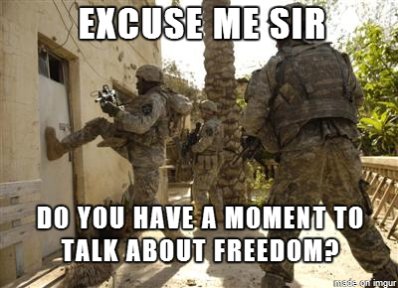
Shut up, he explained.

Slide 17
It’s just “this world”

Slide 18
Was the hand position the only problem?

Slide 19
How to beat a police officer with an American flag

Slide 20
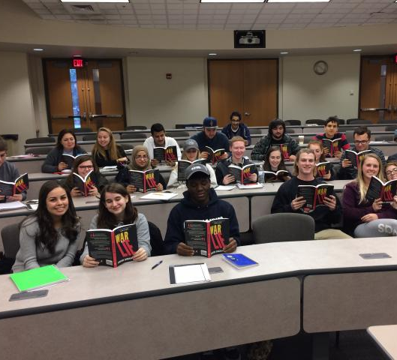
War Is A Lie

Slide 21
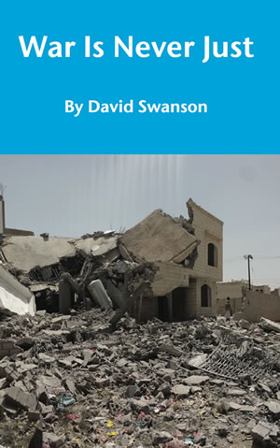
Just wars and unicorns

Slide 22
Lying people into wars for democracy

Slide 25
Thank you for your service

Slide 26
What people can create, people can replace

Slide 27
THANK YOU
david@davidswanson.org
https://davidswanson.org
https://worldbeyondwar.org

